Slide 1
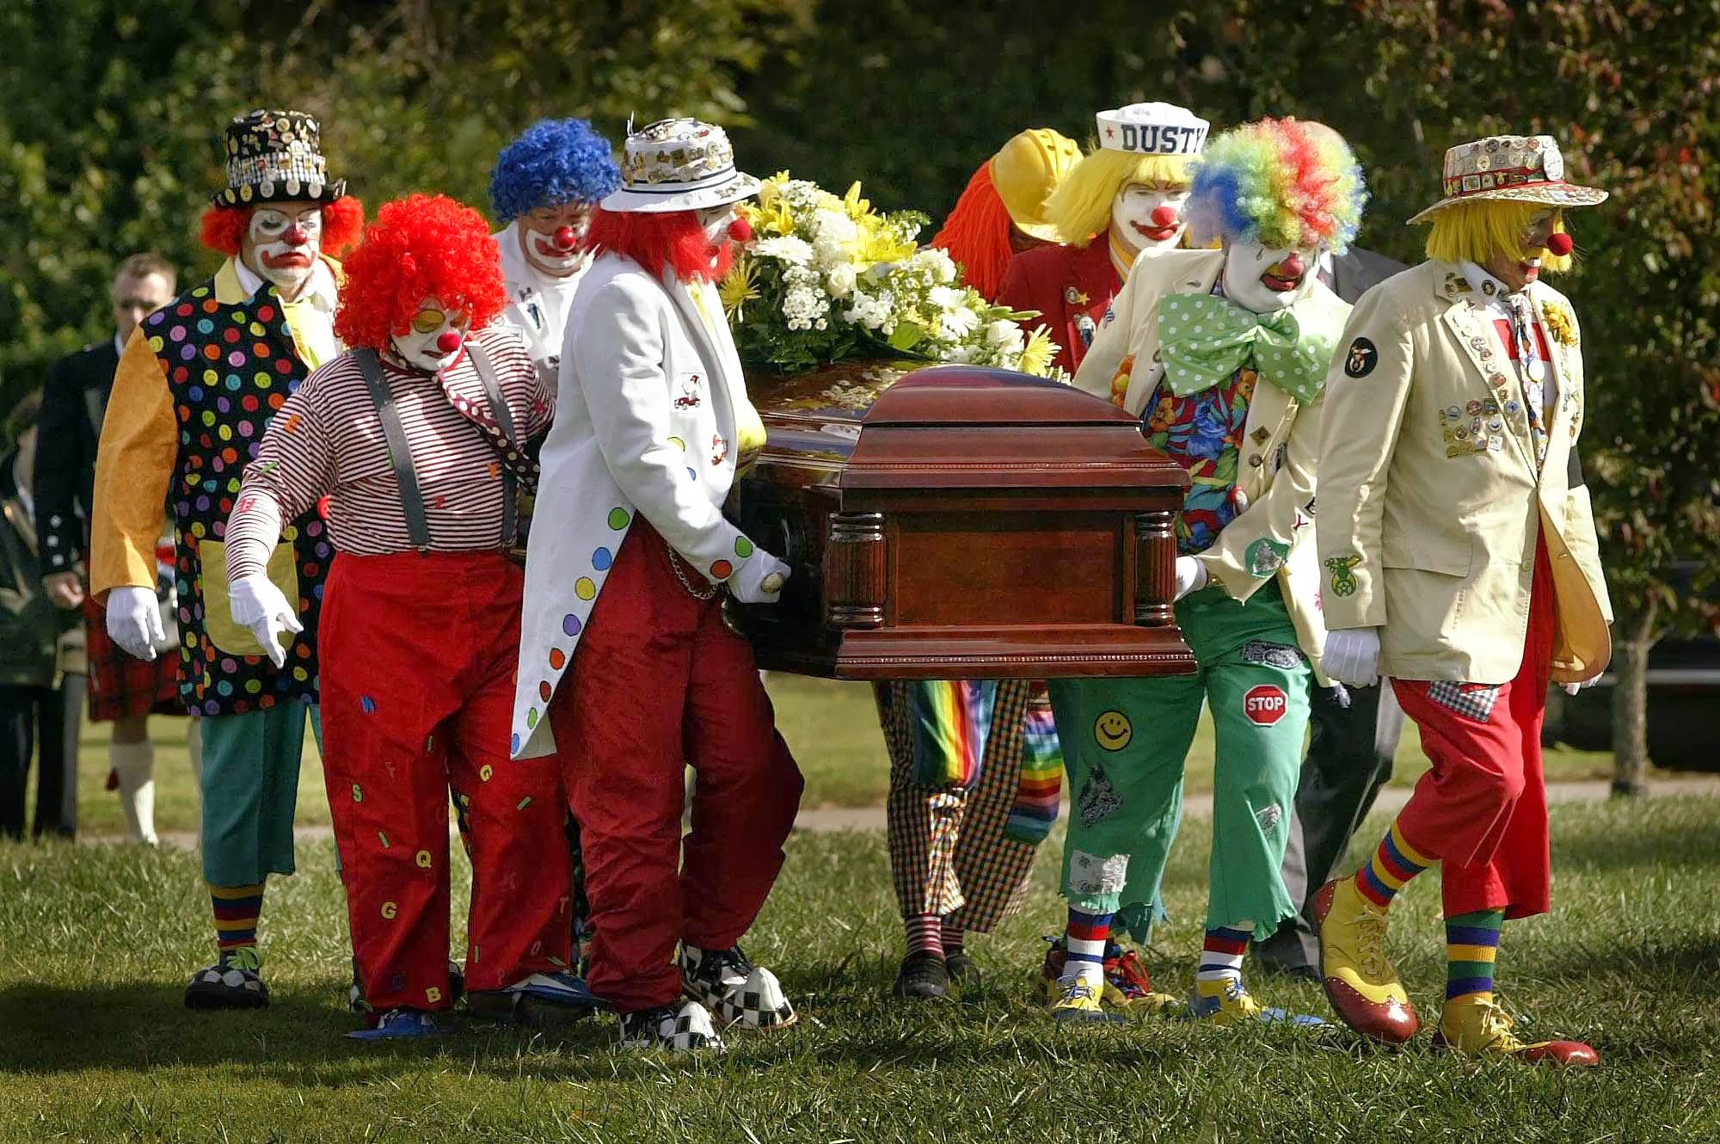
LEADERSHIP
IS DEAD
YOUR INFLUENCE IS NOT

Slide 2
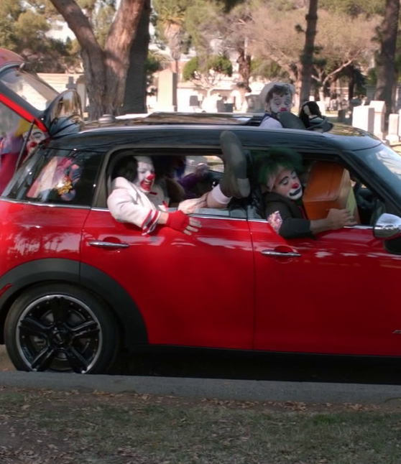
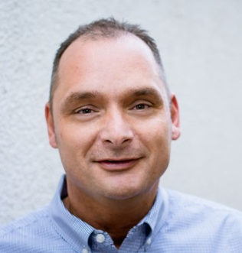

A LITTLE ABOUT
ME AND MY DEATH
Jonathan “JJ” Jarrell
Corporate, Director Human Resources

Slide 3
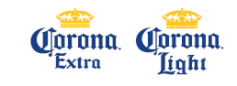
SOME OF THE BRANDS WE SELL

Slide 4

CREATING AND MAINTAINING A WORLD CLASS COMPANY

Slide 5
DEFINING WORLD CLASS
Doing the right thing…
The right way…
All the time!

Slide 6

CORE VALUES
team
Working together for a common purpose or goal.
communication
Timely. Effective. Respectful.
excellence
An expectation of superior performance while successfully achieving results.
Honesty
Complete truthfulness to yourself, co-workers and others.
Trust
Firm reliance in yourself,
co-workers and the company.
Pride
Respect for your work, yourself, co-workers and the company.
Loyalty
Faithful commitment
to co-workers and the Company.
Creativity
Using imagination to drive innovation.
Community
Contribution
Giving back with caring.

Slide 7
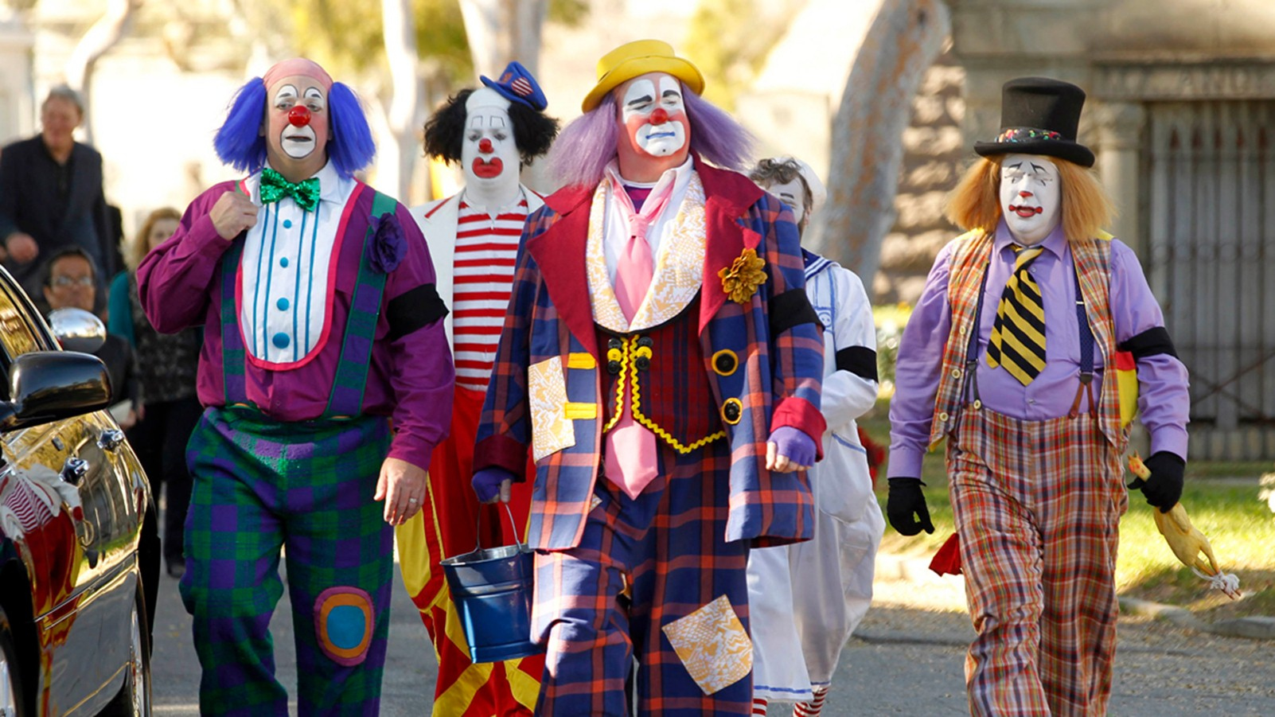

WHY LEADERSHIP
IS DEAD
THE BULLY BOSS
THE GHOSTS BOSS
THE MICROMANAGER BOSS
THE CREDIT TAKER BOSS
THE BEST FRIEND BOSS
THE SQUIRREL BOSS
THE DEVISIVE BOSS
THE WORKAHOLIC BOSS
THE NARCISSISTS BOSS
THE UNFILTERED BOSS

Slide 8
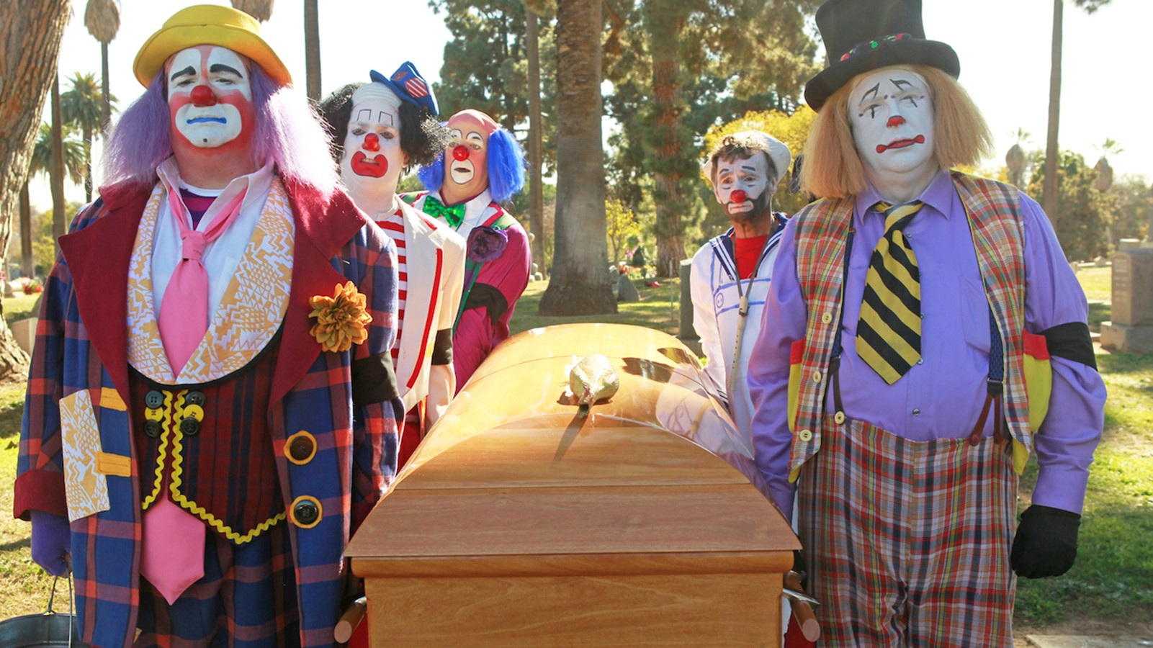
10
QUESTIONS
TO HELP YOUR LEADERSHIP
COME ALIVE

Slide 9
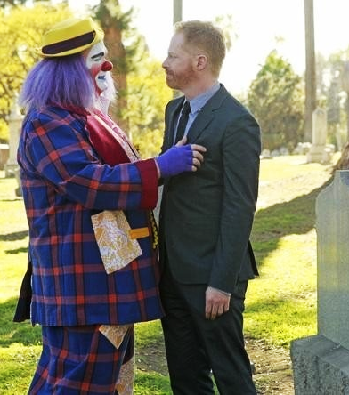

ARE YOU THE CHIEF MEANING OFFICER?
1
Breakdown silos
Get rid of clutter
Love to see people
float and succeed
Remember you're
responsible for people lives

Slide 10
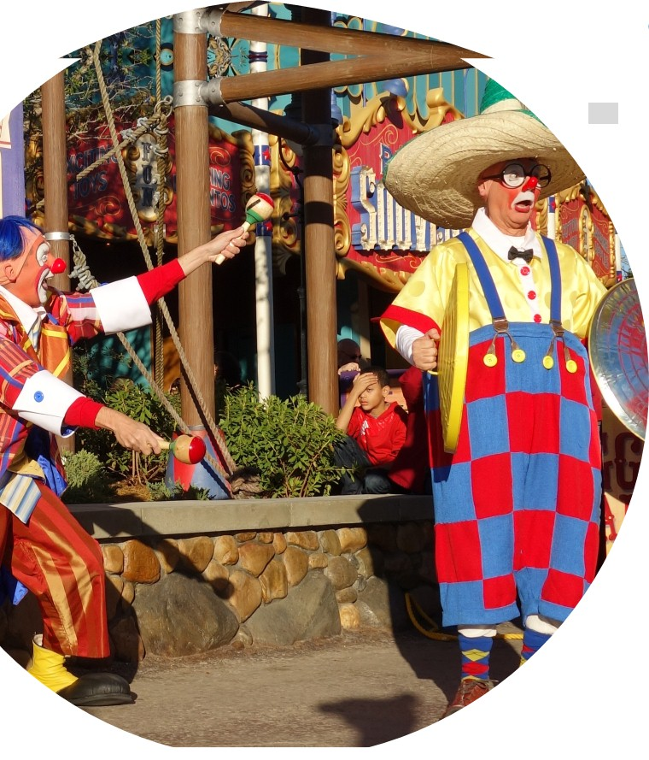

DO YOU UNDERSTAND
YOUR BUSINESS?
2
When was the last time
you took a day to work
in a different department.
When was the last time you took someone outside your department to lunch?
When was the last time you participated in “other” department meetings?

Slide 11
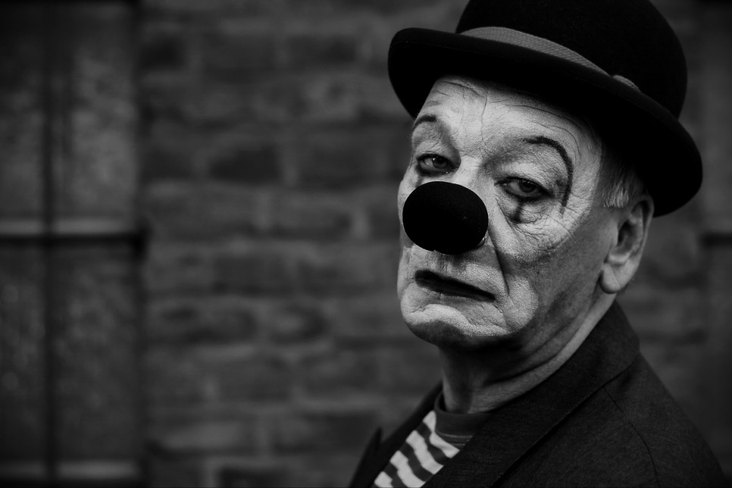

HAVE YOU SLOWED DOWN TO SPEED UP LATELY?
3
Do you really get clear of
what your objectives are
Are you taking the time to look at your competitors?
What are they doing differently? (HR Peers)
Time in, erodes your awareness of

Slide 12
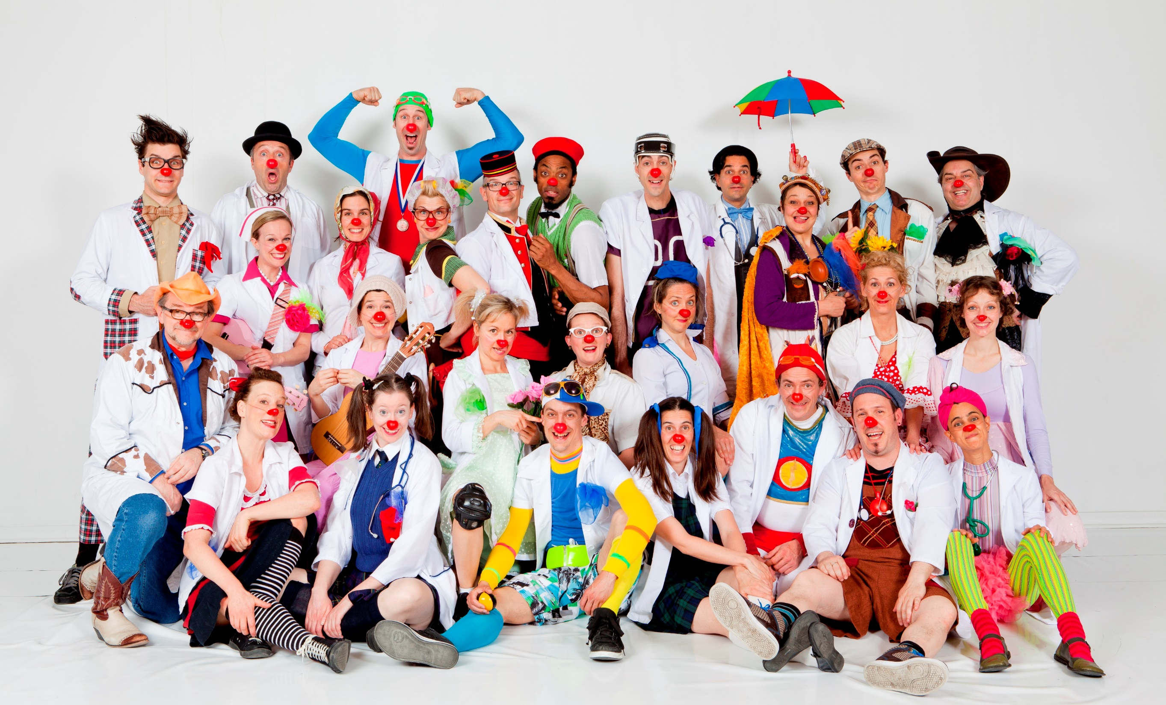


DO YOU KNOW
YOUR COMPETITIVE ADVANTAGE?
4
People are our greatest……..best time to fire?
20/60/20 Build People
One factor: the level of highly satisfied, engaged and trained employees in your business. (PD)

Slide 13
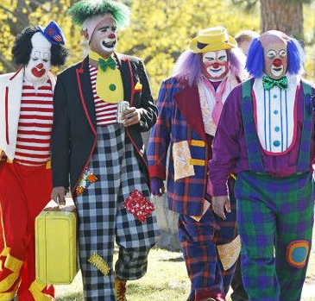

DO YOU TRULY UNDERSTAND CHANGE WILL HAPPEN?
5
The rate of internal change must exceed the rate of external change
Apply this to your career
Your current role will not be the same
in one year

Slide 14
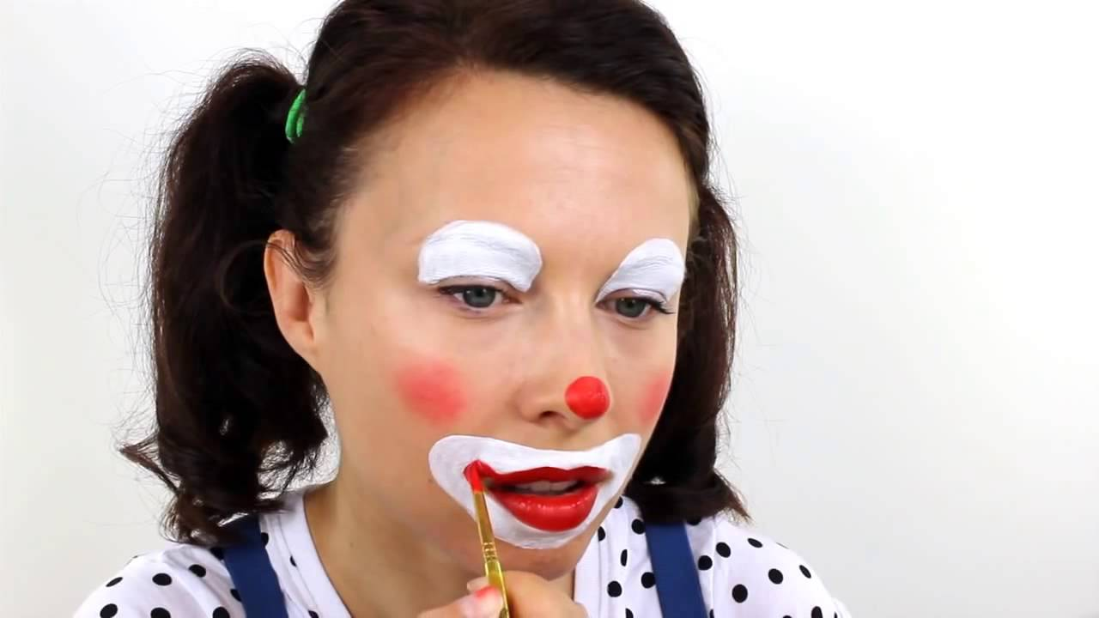


DO YOU ADVISE YOURSELF?
6
When you take your own advise
the answers are very clear.
If you were replaced
what would they do?

Slide 15

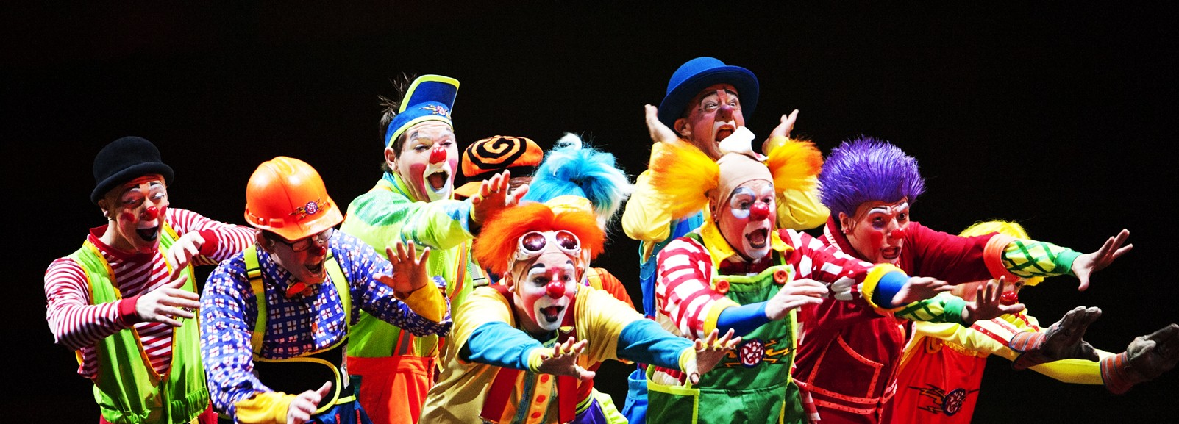
DO YOU HAVE AUTHENTIC HAPPINESS?
7
Are you genuine
with people?
Are you resilient and do you have grit?
Do you stay in the moment?
PENN State University
Neuroscience

Slide 16

Grab A Partner
Someone you did not come with and you do not know

Slide 17

Partner “A”
Tell your partner a recent exciting event with all the conviction and enthusiasm you can stand. Get in their face show them how excited you are.
Make them look you in the eye.. Have fun…

Slide 18
Partner “B”
Do your best to ignore Partner “A” , don’t make eye contact, walk away, cross your arms act uninterested.
SAY NOTHING

Slide 19
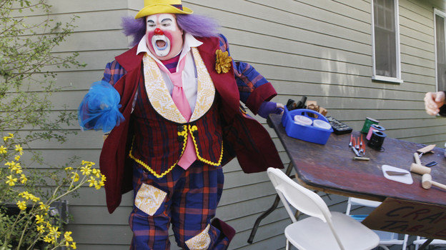
How did that feel?

Slide 20
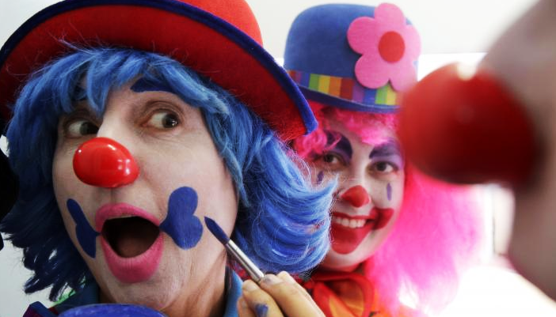
8
Do you hold yourself accountable first?

Slide 21
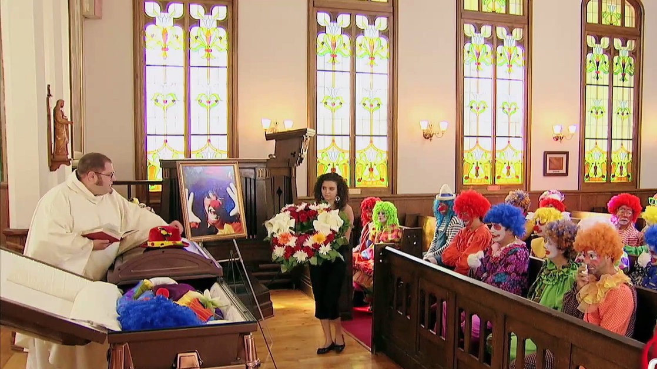
9
Do you take time to invest in yourself?

Slide 22
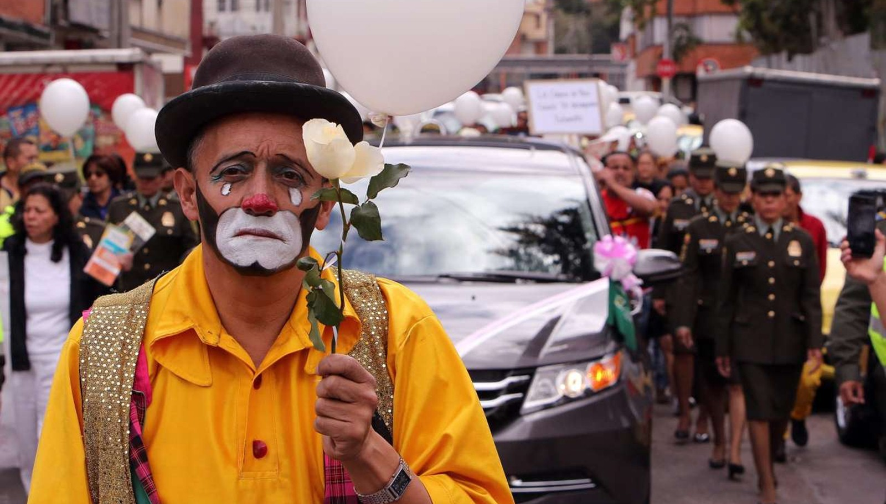
10
Do you know leadership is not about you?
It’s a gift!

Slide 23

Jonathan “JJ” Jarrell
jjarrell@conedist.com
352-438-7503
Connect with me
on Linkedin!!

